Slide 1
Behavioral tracking and control using Bonsai
Intro and tutorial
Adriana Nagy-Dabacan
31.01.2025

Slide 2
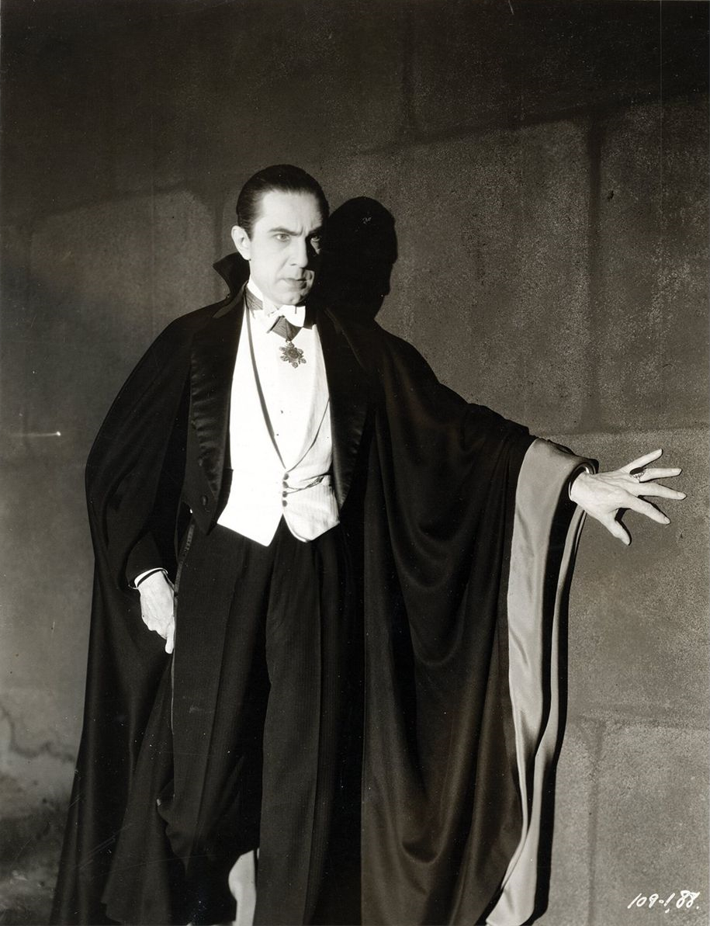
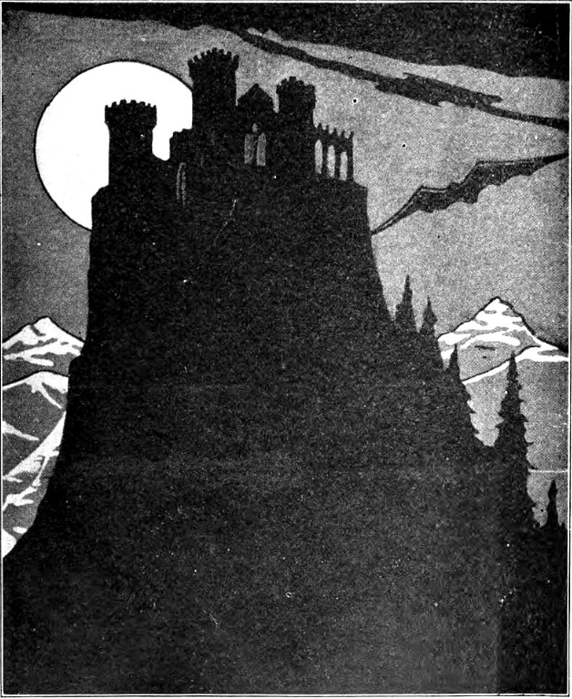
TINS, TENSS and Transylvania
Wikipedia commons

Slide 3
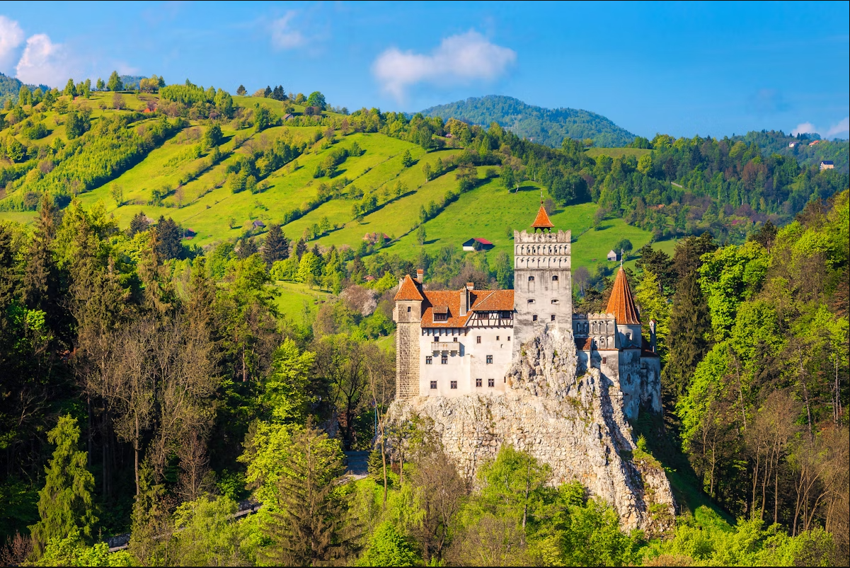
TINS, TENSS and Transylvania
Lonely Planet

Slide 4
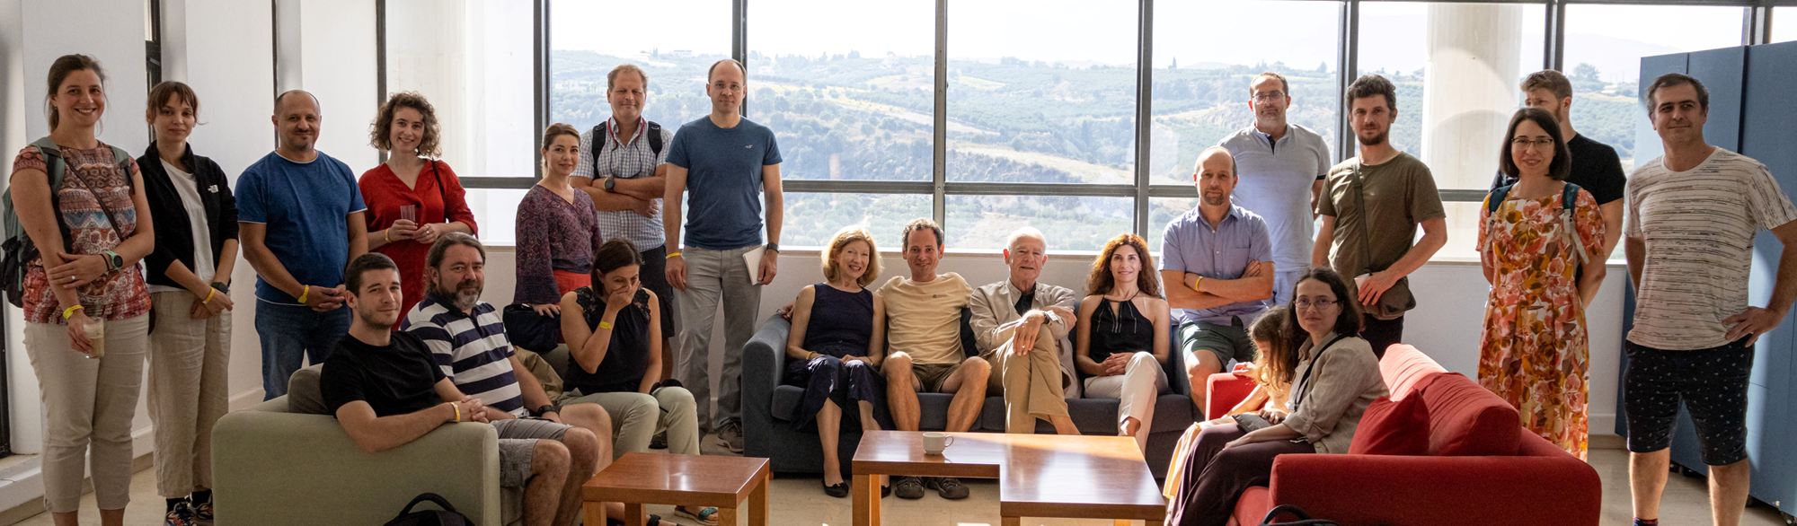
TINS – Transylvanian Institute of Neuroscience

Slide 5
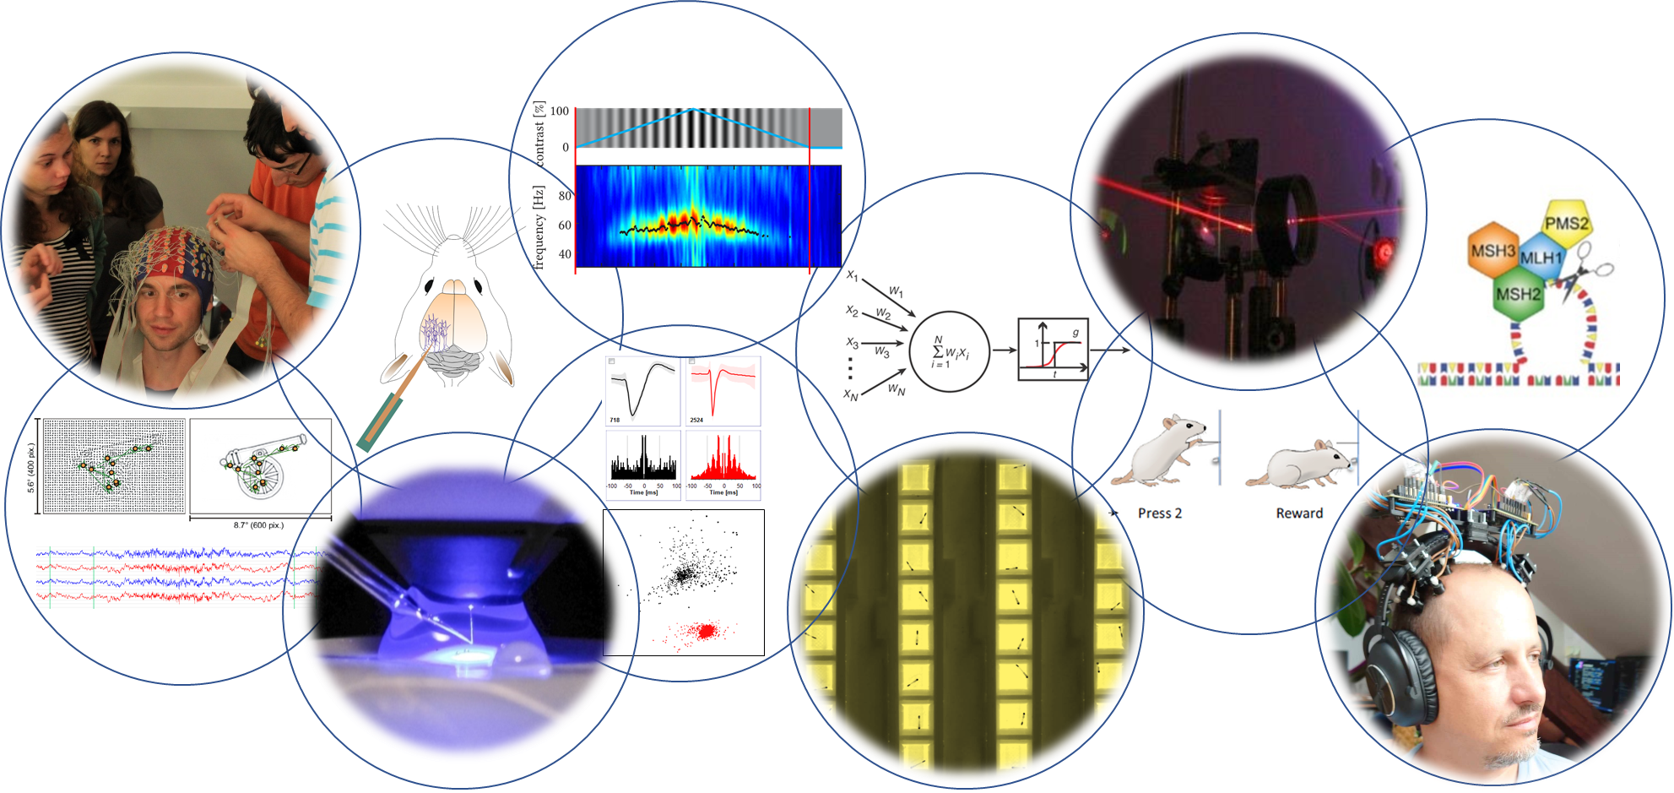
TINS – Transylvanian Institute of Neuroscience

Slide 6
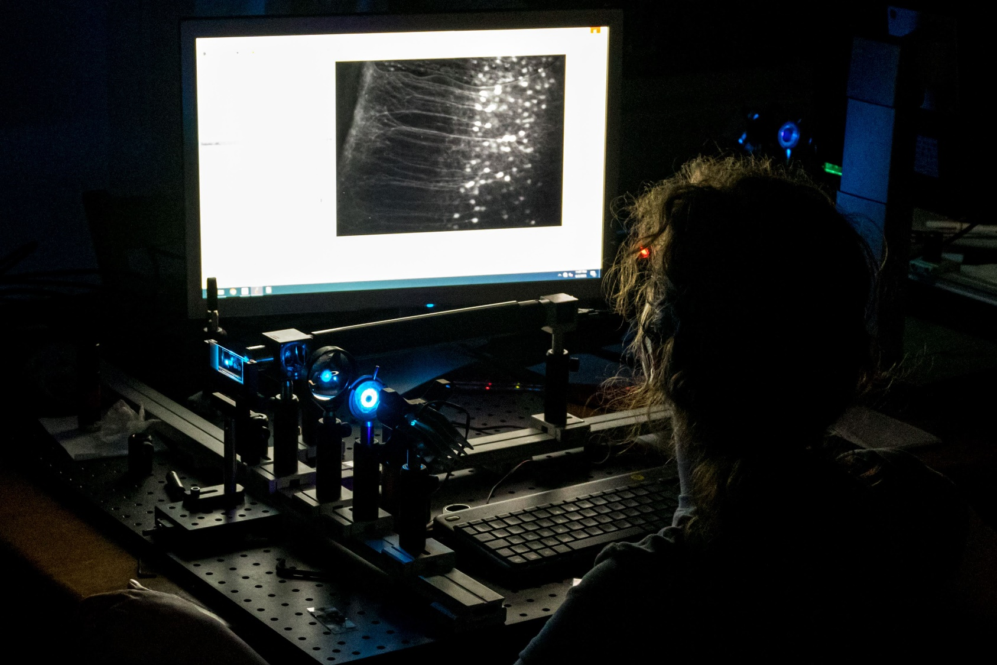
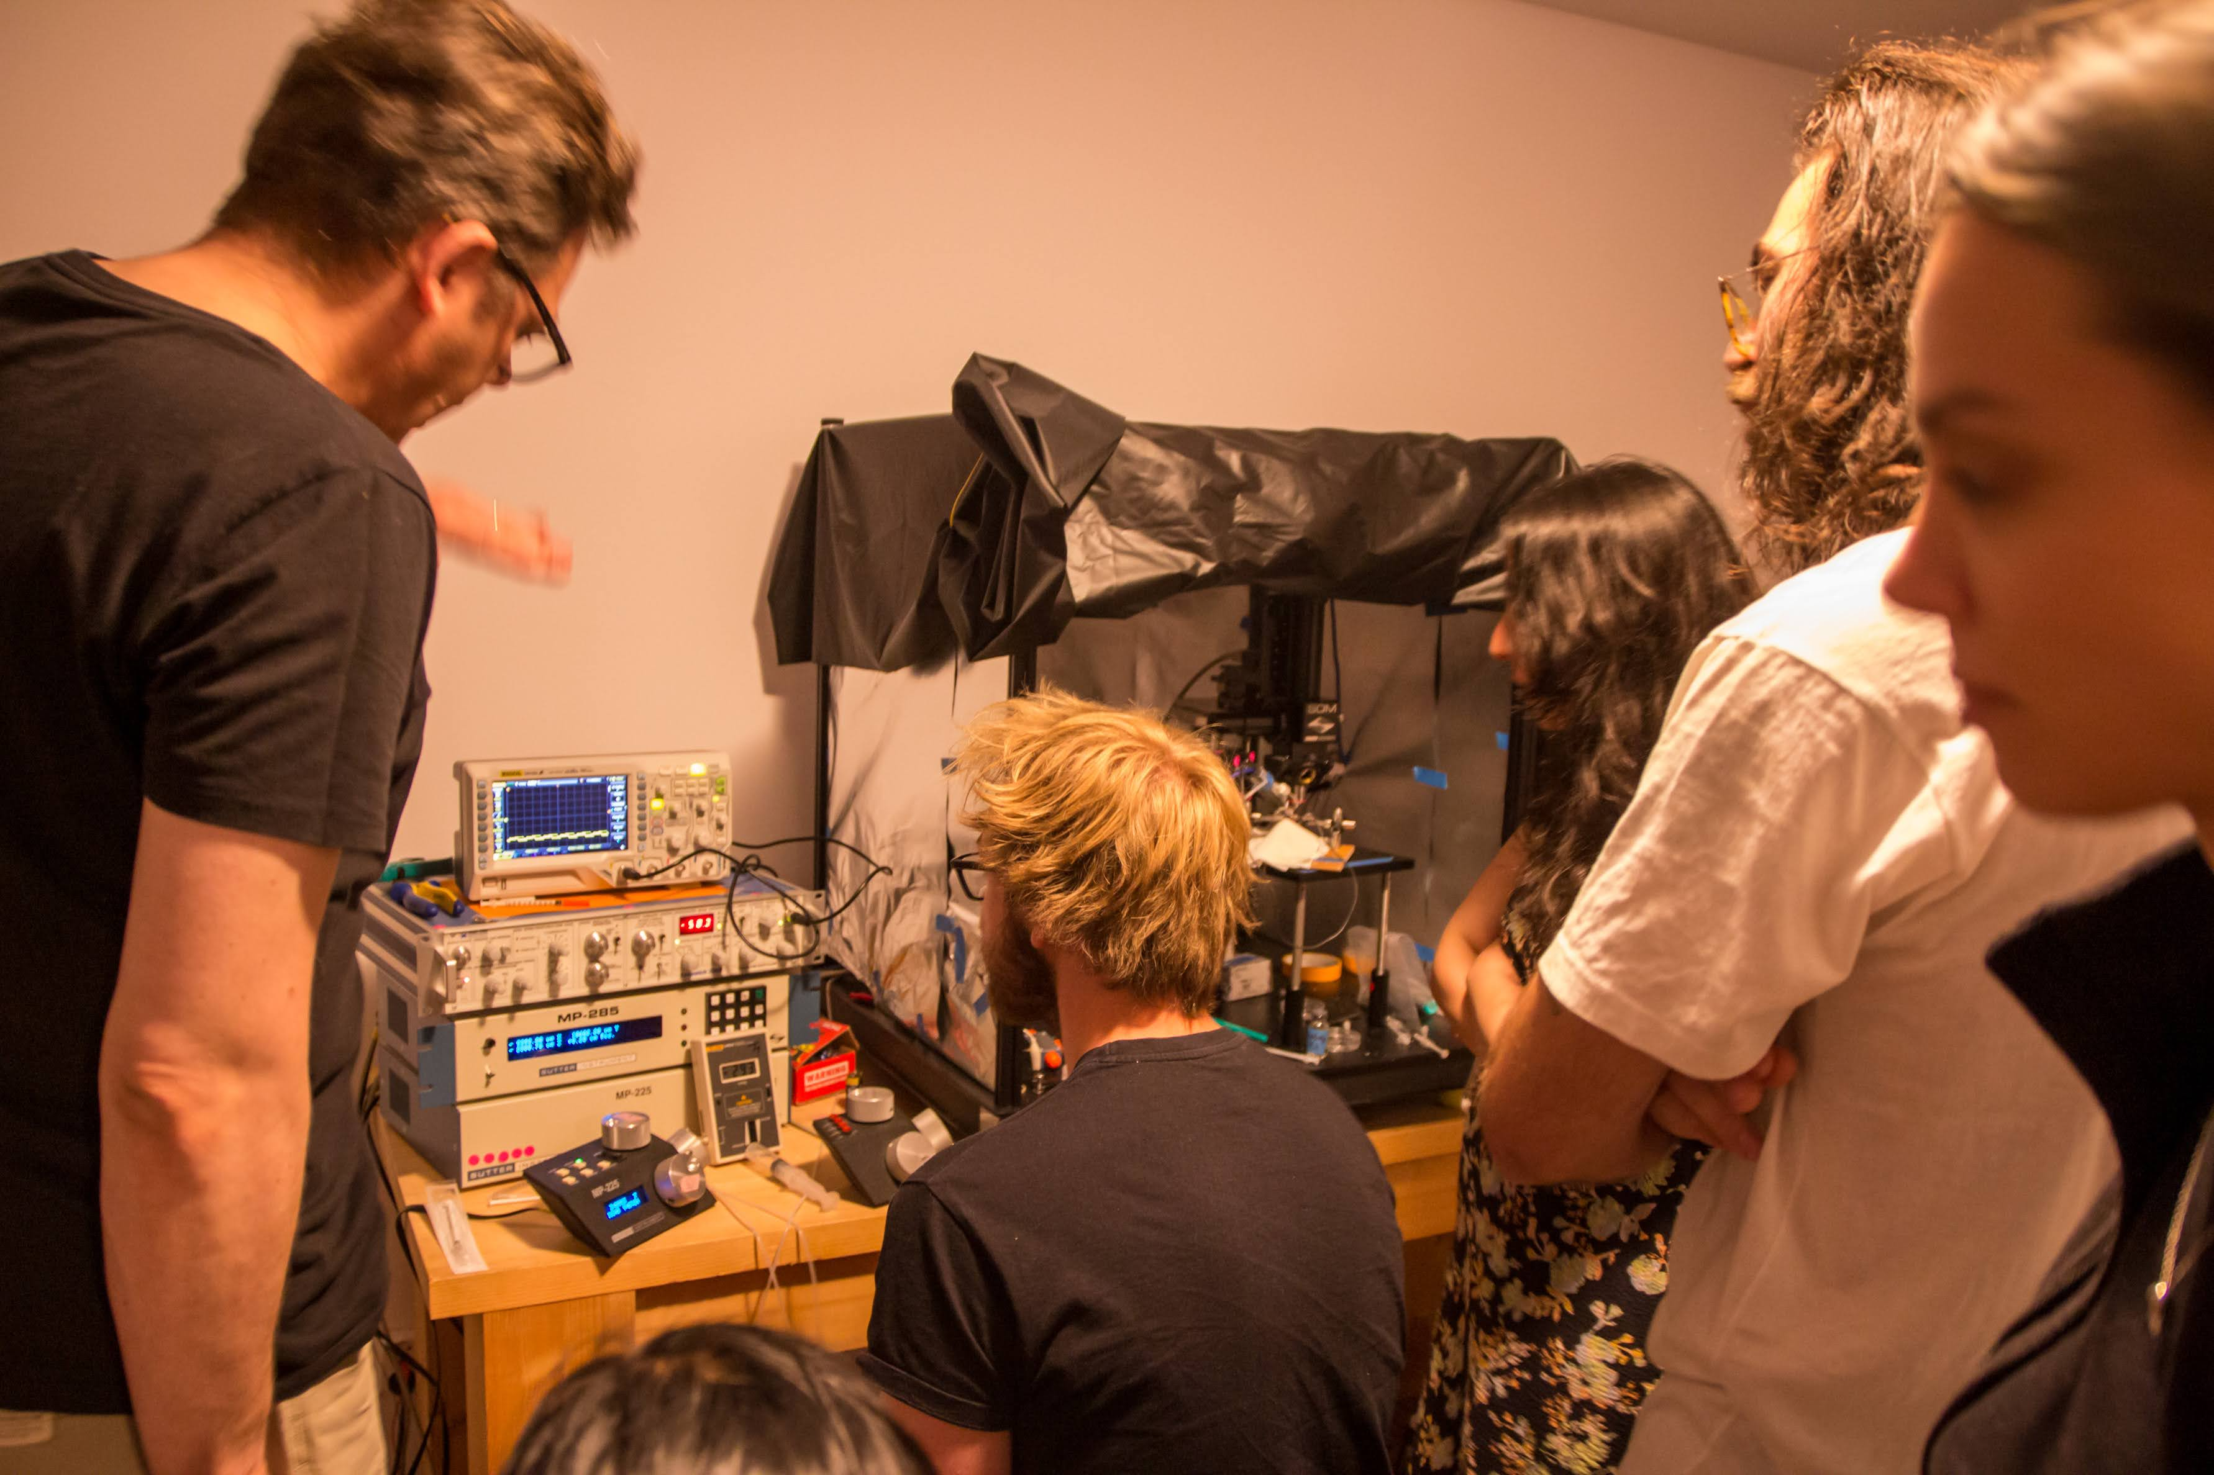
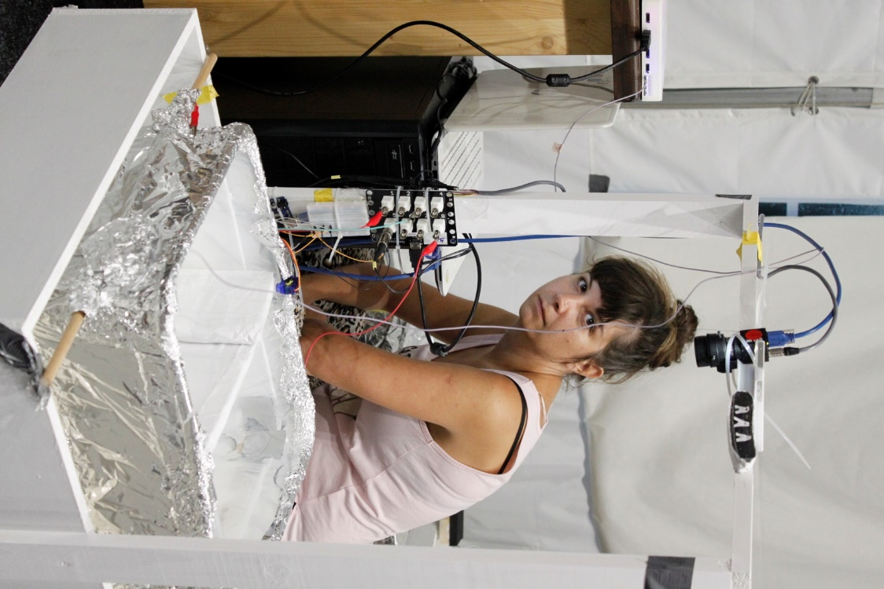
TENSS – Transylvanian Experimental Neuroscience Summer School
Microscopy
Electrophysiology
Behavior

Slide 7

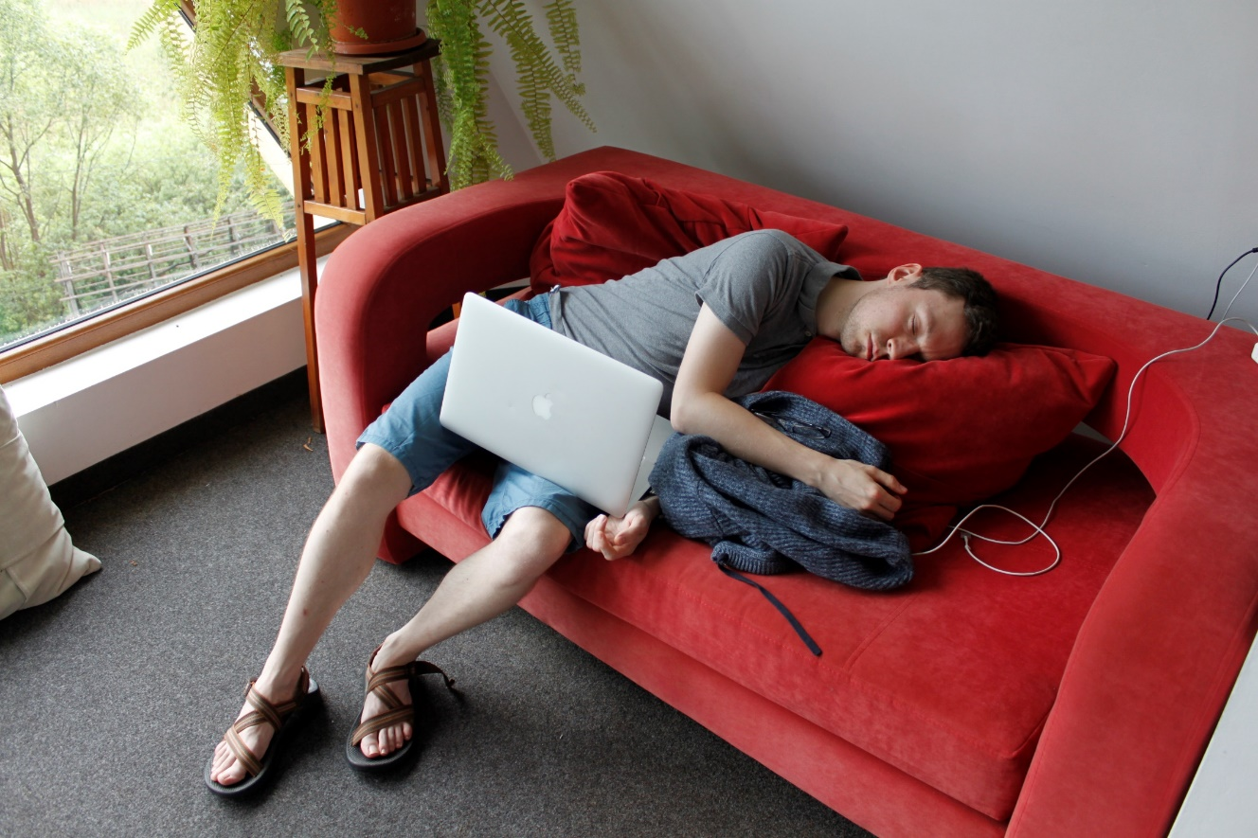
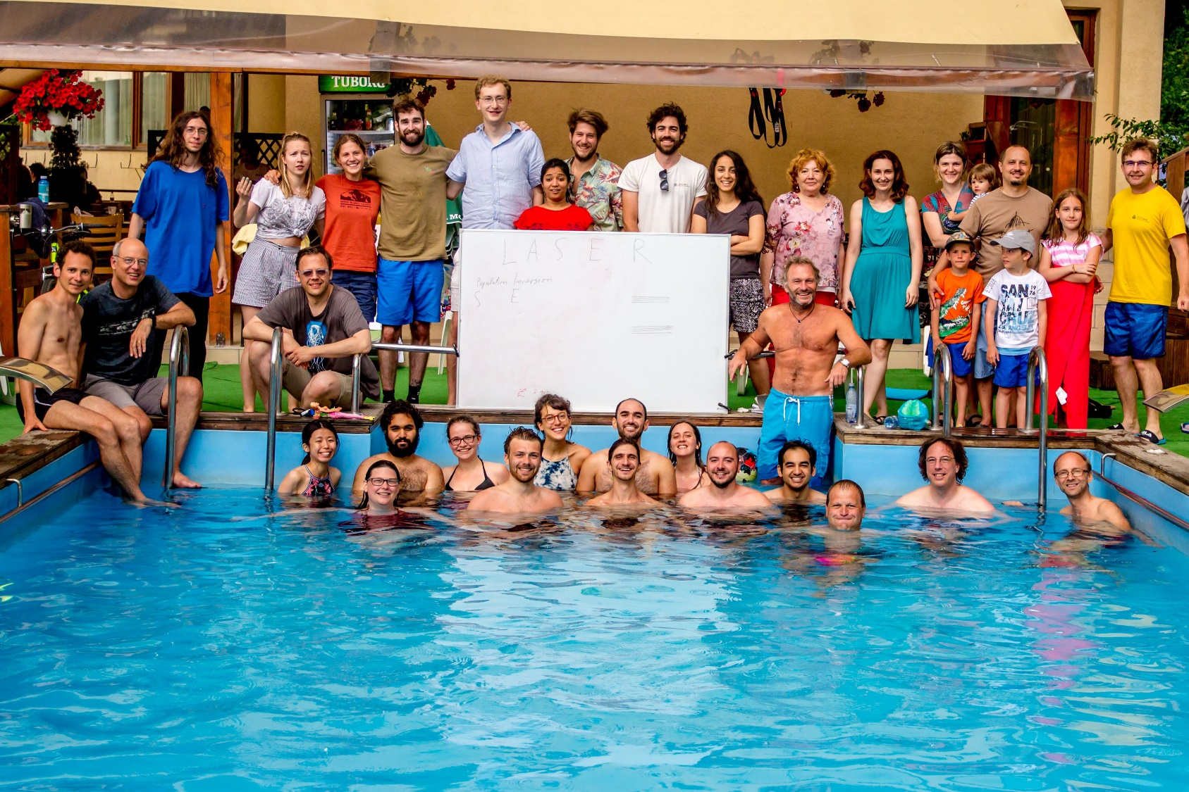
TENSS – Transylvanian Experimental Neuroscience Summer School
Fun
Nature
Sleep deprivation

Slide 8
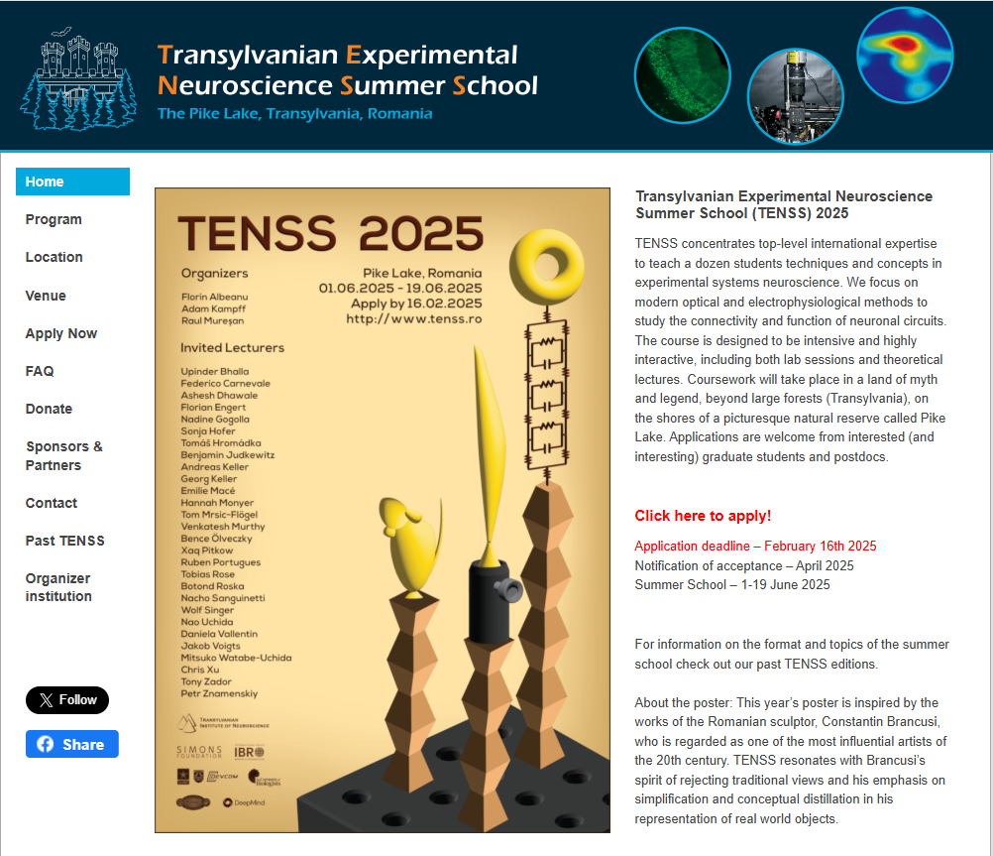

Slide 9
What is Behavior?
“The total movements made by the intact animal” (Tinbergen, 1955).
“Behavior is the internally coordinated responses (actions or inactions) of whole living organisms (individuals or groups) to internal and/or external stimuli, excluding responses more easily understood as developmental changes” (Levitis et al., 2009)
“Behavior is a unifying organismal process where genes, neural function, anatomy and environment converge and interrelate.”
Animal behavior is the macroscopic expression of neural activity, implemented by muscular and glandular contractions acting on the body “plant” and resulting in egocentric and allocentric changes of the animal in an organized temporal sequence. (Gomez-Marin et al., 2014).

Slide 10
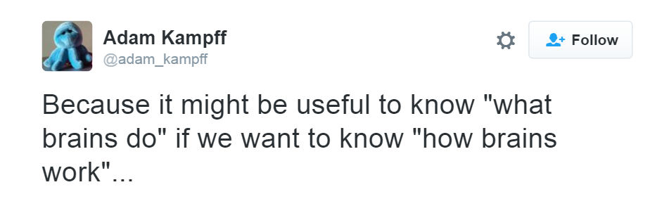
Why study behavior?

Slide 11
What does behavior “look” like?
Movement of the animal or of specific body parts
Generation of sound (vocalization / non vocalization)
Production of substances and odors
Production other signal modalities, electric signals, change in color, etc.
Does un-manifested behavior exist?
How about a change in internal state?
Is thinking a behavior? Is planning your future behavior a behavior?

Slide 12
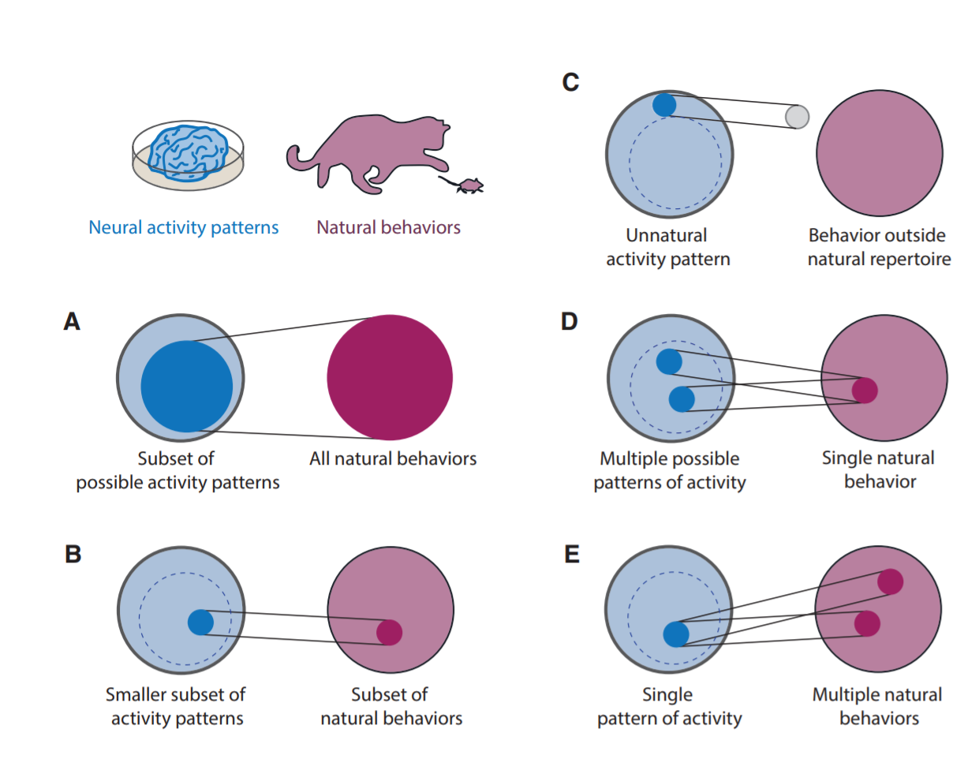
Neuroscience needs behavior
Krakauer et al., Neuron 2017

Slide 13
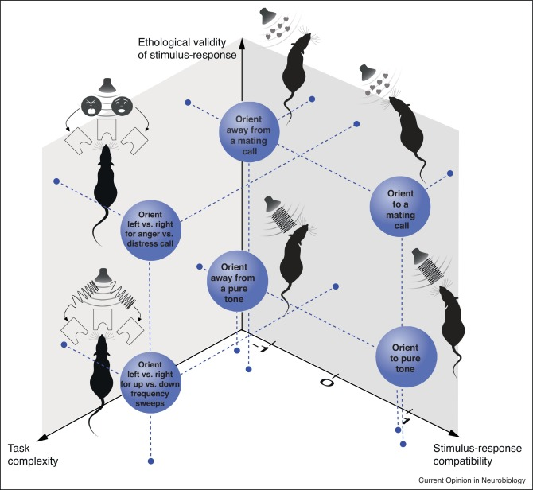
But behavior needs to be appropriate
Motivation
Performance =
Resistance
Juavinett et al., 2019

Slide 14


But behavior needs to be appropriate
Pressure / Reward - Satiation
Motivation
Performance =
Resistance
In-appropriateness:
complex / irrelevant / incompatible
Juavinett et al., 2019

Slide 15
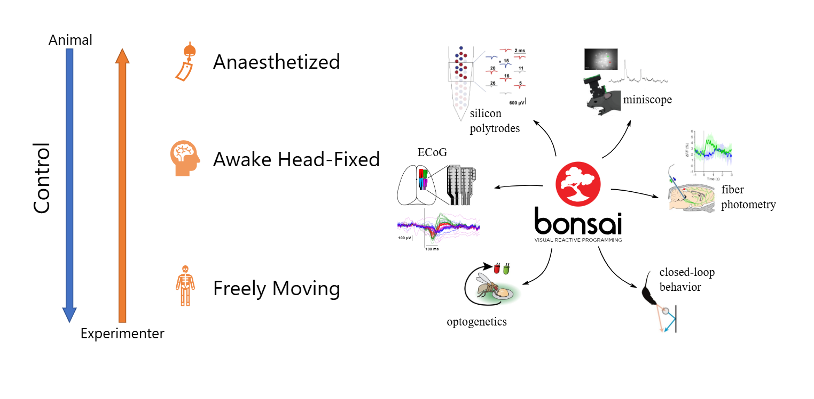
And we compromise

Slide 16
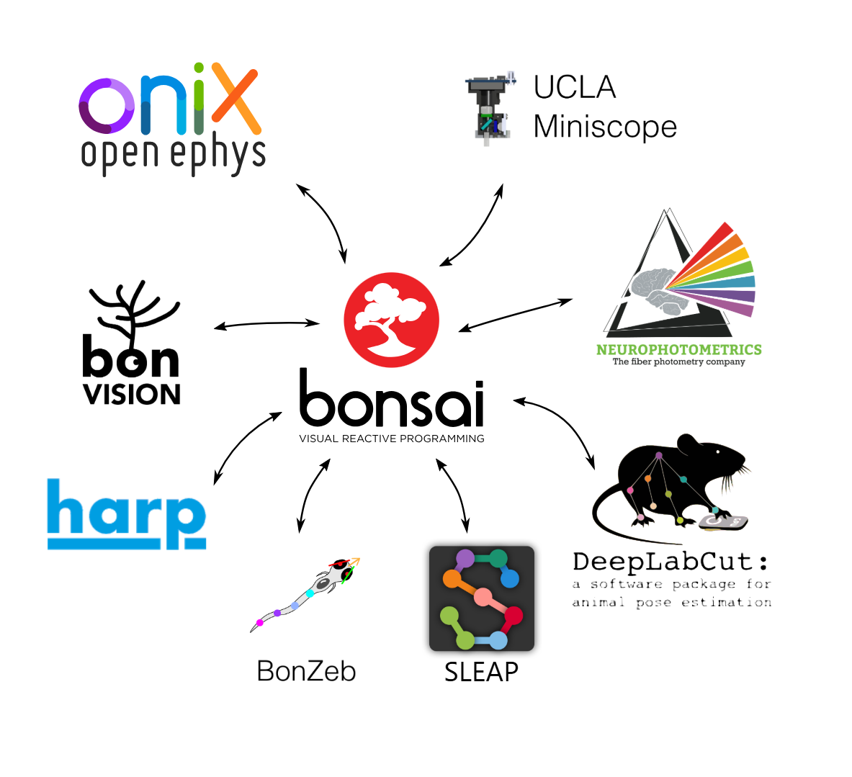
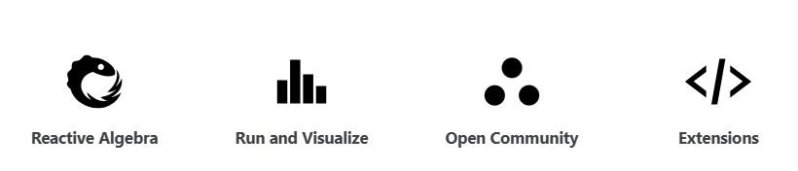

Slide 17
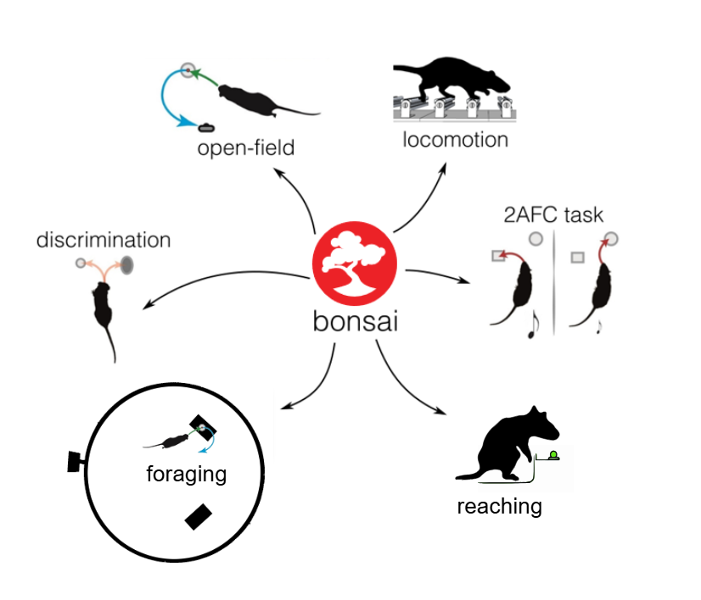

Slide 20
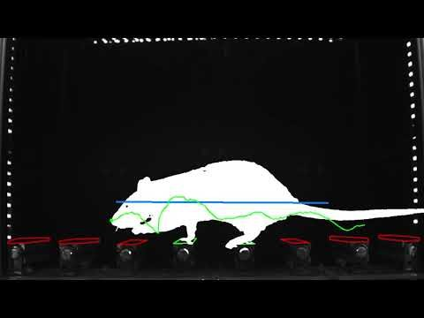

Slide 21
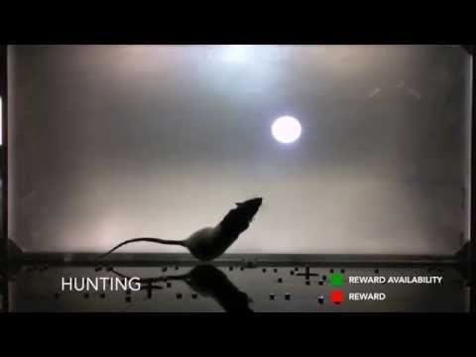

Slide 22
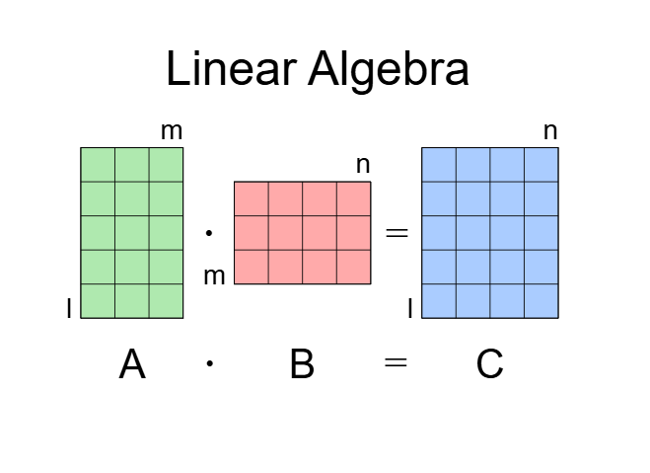
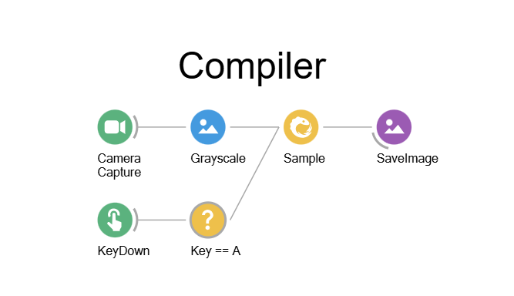

Slide 23
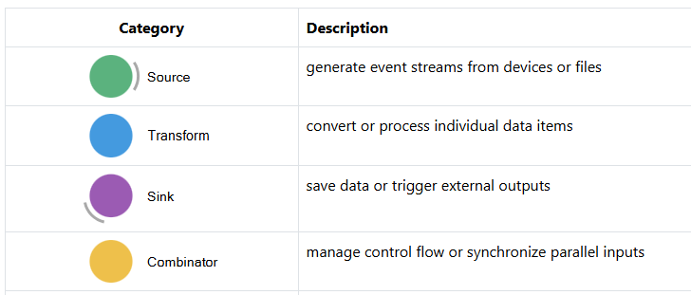

Slide 24
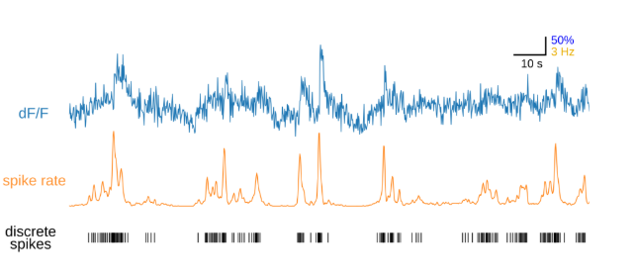
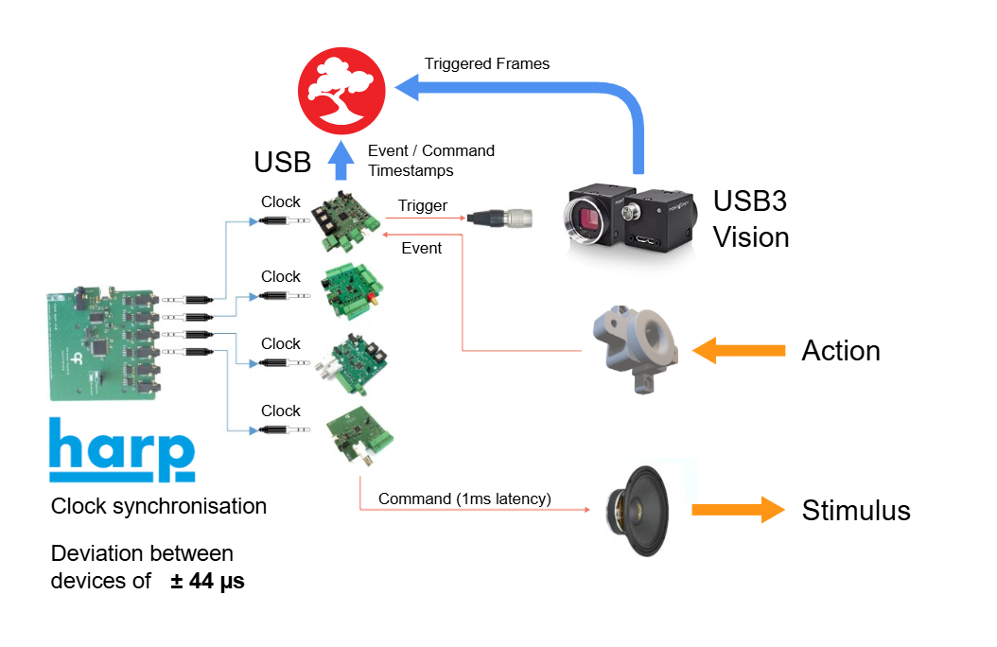

Slide 25
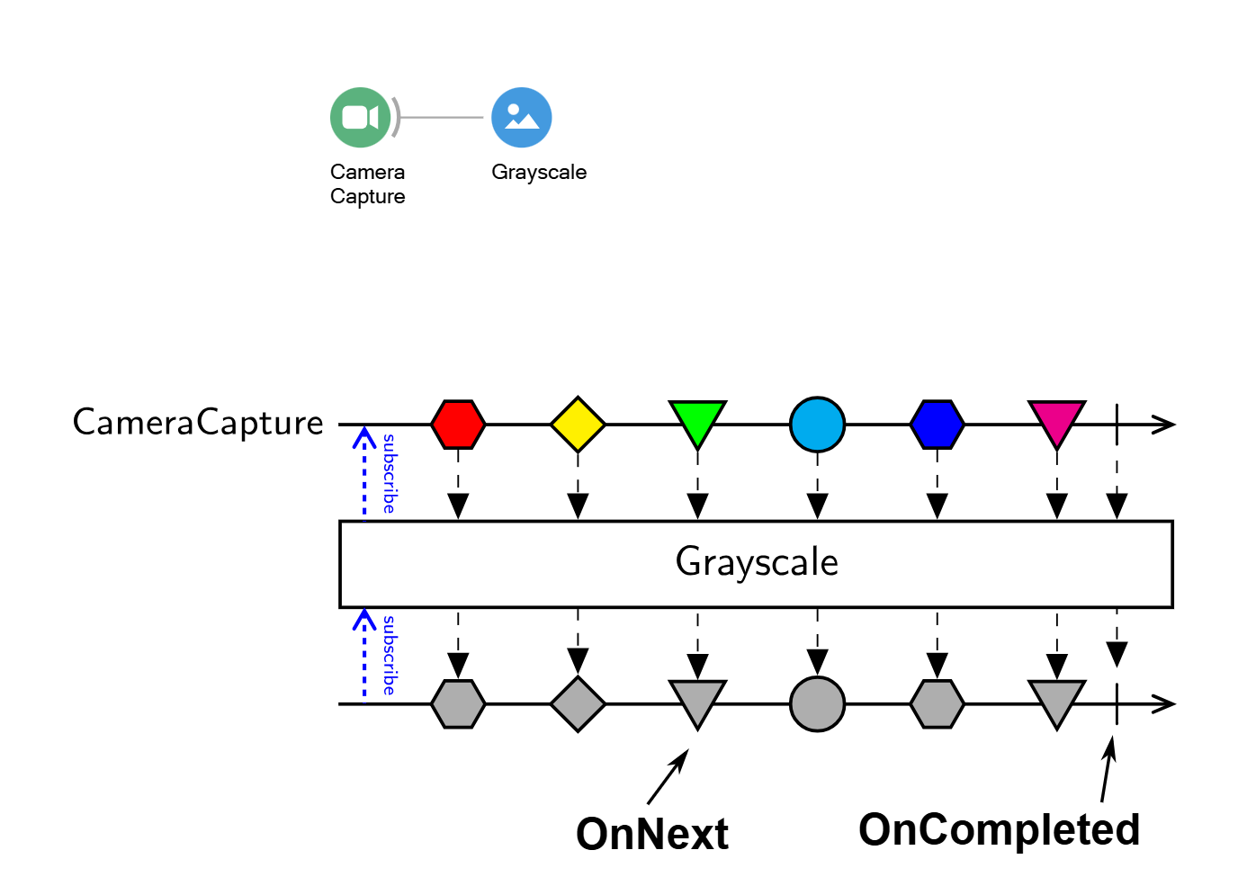

Slide 26
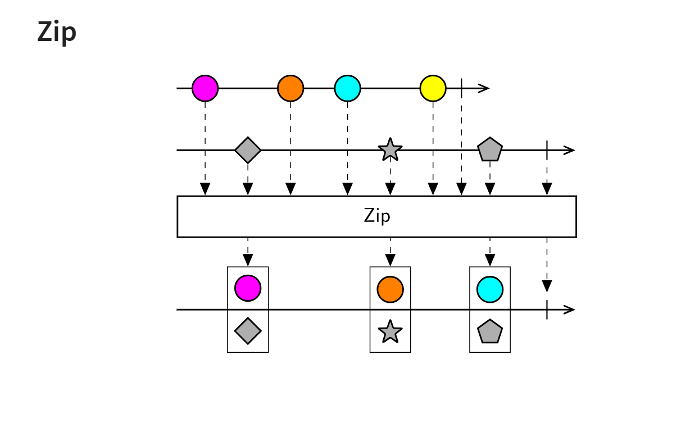

Slide 27
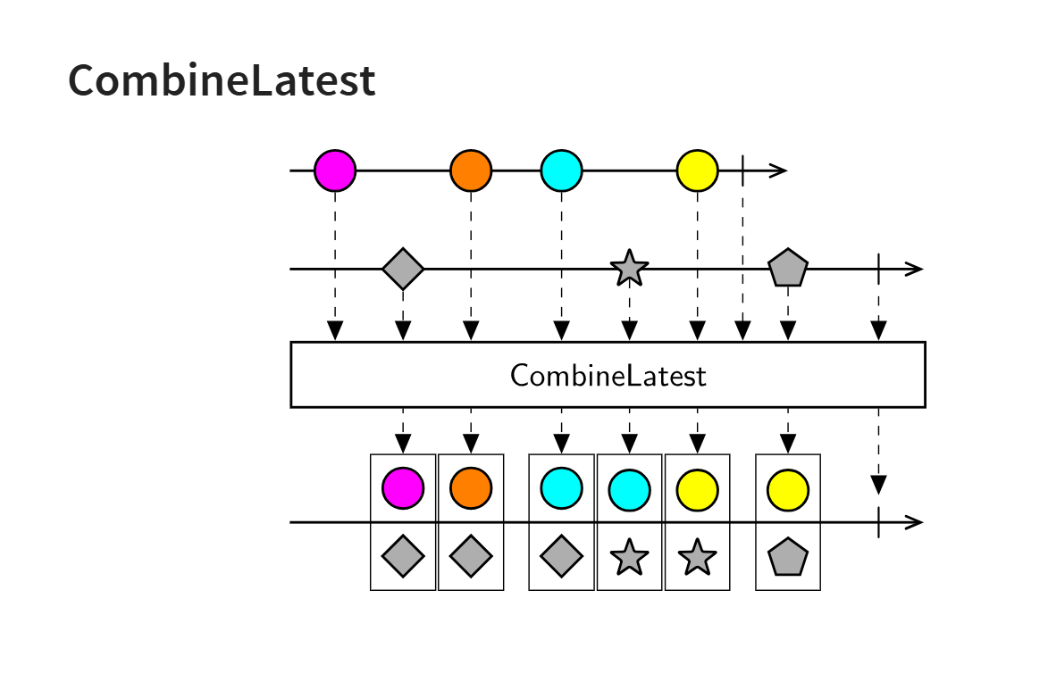

Slide 28
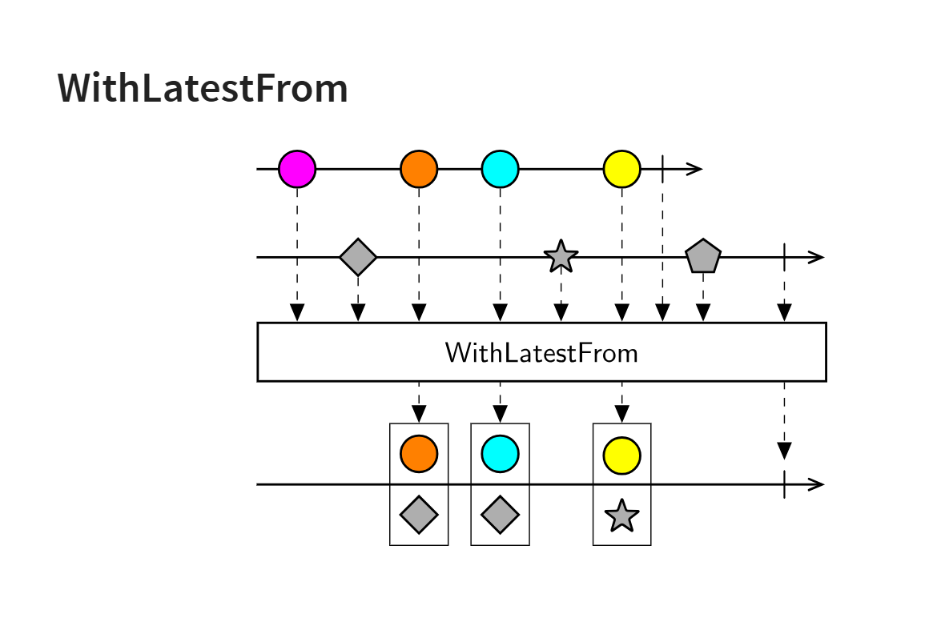

Slide 29
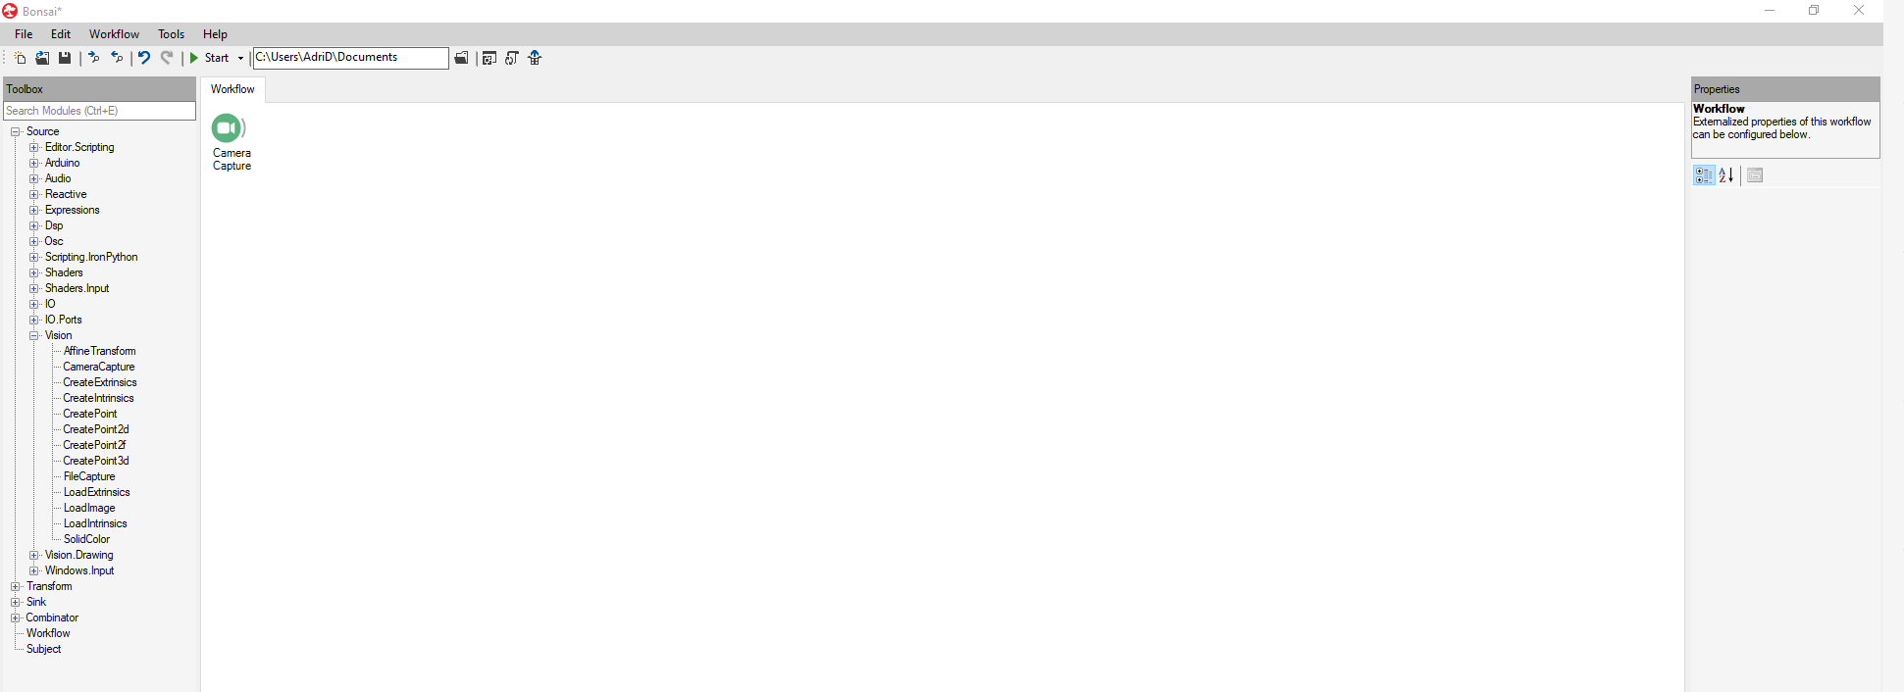
Make friends with Bonsai

Slide 30
Make friends with Bonsai

Slide 31
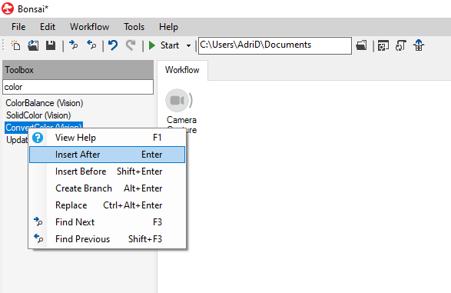
Experiment with live sources, vision transforms, visualizers.

Slide 32
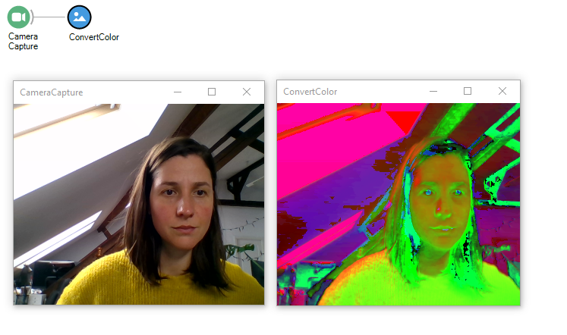
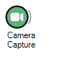
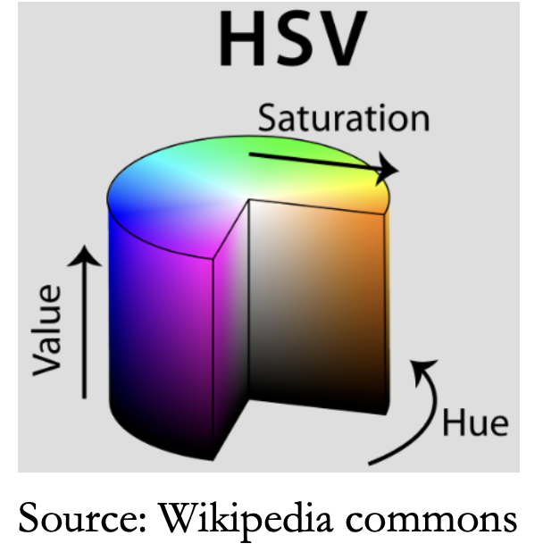
Experiment with live sources, vision transforms, visualizers.

Slide 33
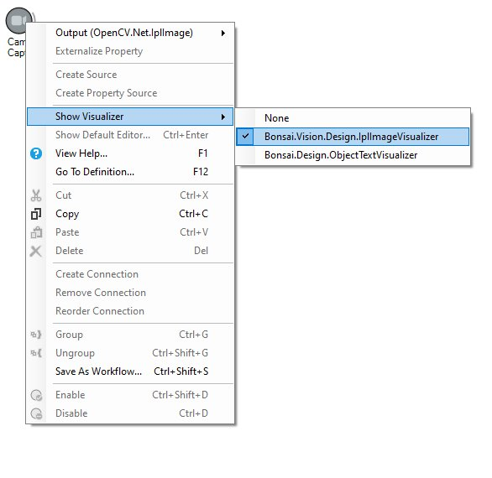
Experiment with live sources, vision transforms, visualizers.

Slide 34
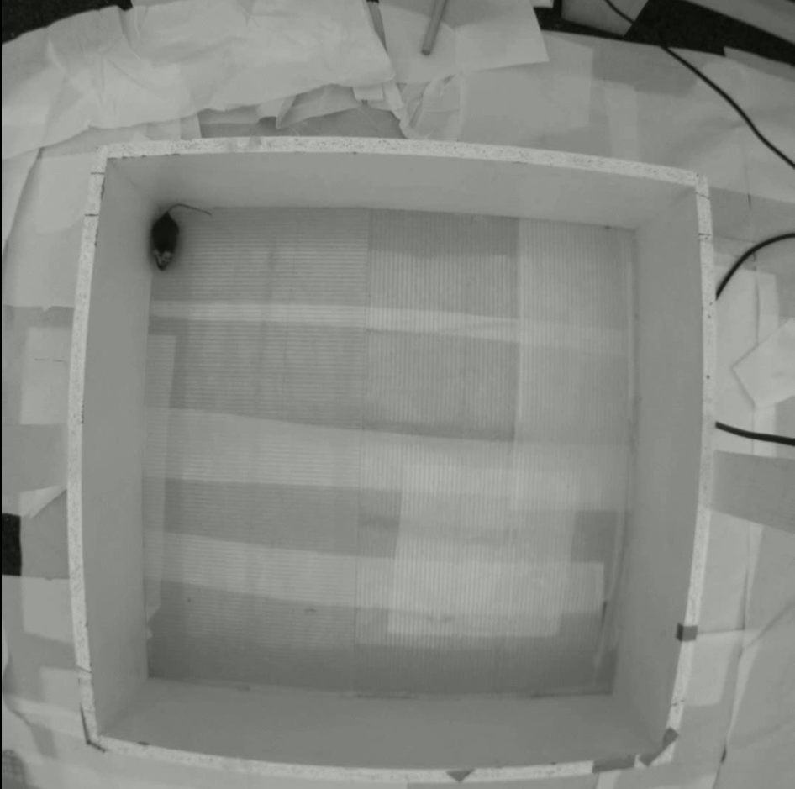
Our task for today:
Simple "Closed loop" experimental setup:
Play sound when mouse is outside its home area.

Slide 35
The workshop, step by step
Read "mouse in arena" video file.
Preprocess the video: crop, convert color space.
Detect mouse: threshold, dilate, find contours, select mouse ROI, extract position.
Group workflow for easy readability.
Generate logic for determining whether mouse is outside of home area.
Replace node logic with python transform.
Generate a sound when mouse is within the predefined home area.
Save some data.
Discuss further development.

Slide 36
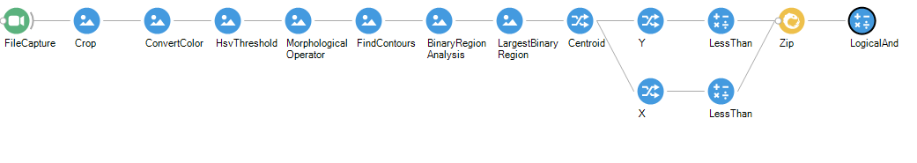
Read video, preprocess, detect mouse centroid.

Slide 37
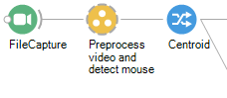
Group workflow

Slide 38
Generate logic for determining whether mouse is outside of home area.

Slide 39
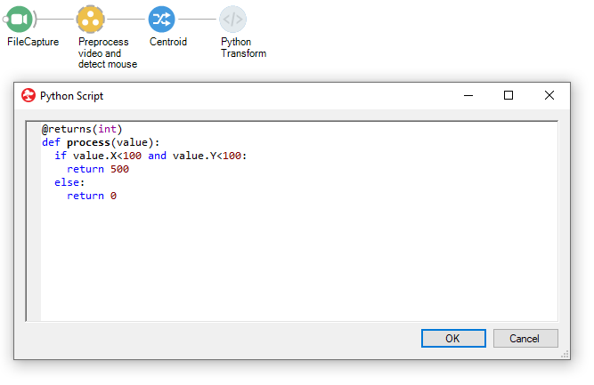
Replace logic with python script

Slide 40
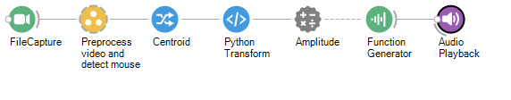
Play sound when mouse is at home

Slide 41
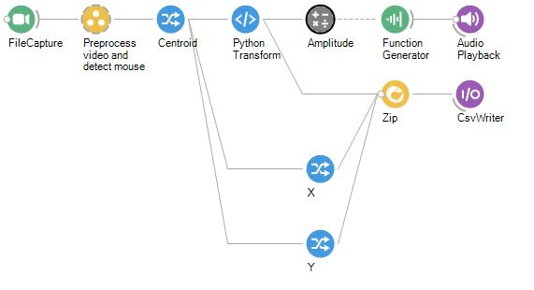
Save X and Y position over time, together with sound amplitude

Slide 42
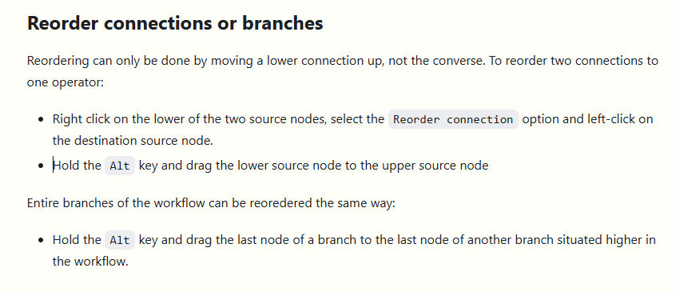
Save X and Y position over time, together with sound amplitude

Slide 43
Further developments
Use a hot source instead of a cold one
Integrate imaging/ephys data and synchronize it
Trigger audio when neuron X is active
Build visual reality environments
Integrate DeepLabCut or other cool segmentation tools for better animal detection
And so on.

Slide 44
Resources
Bonsai Gallery – also within the GUI
Documentation
GitHub forum
Public Discord server
Learning resources
Goncalo Lopez
Nacho Sanguinetti
Mateusz Kostecki

Slide 45



Resources
Bonsai Gallery – also within the GUI
Documentation
GitHub forum
Public Discord server
Learning resources
Goncalo Lopez
Nacho Sanguinetti
Mateusz Kostecki

